Slide 1

Sanjivani College of Engineering, Kopargaon
(An Autonomous Institute, Affiliated to SPPU, Pune)
Department of Computer Engineering, NBA Tier-1 Accredited
TOC CIA (Case Study) Activity Presentation
T.Y. B.Tech – Computer Engineering | AY [ 2026–2027 ] | Div-A
Compiler Token Verification using Turing Machine
Submitted By
Riya Dhakane | Payal Aragade
| Shruti Wakchaure | Chanchal Shinde
Under the Guidance of
Prof. N.G.Pardeshi,
Associate Professor
www.sanjivanicoe.org.in

Slide 2
Introduction
Introduction -
In programming languages, lexical analysis is the first phase of a compiler that identifies and validates tokens such as identifiers, keywords, operators, and literals.
An identifier is a name used for variables, functions, classes, and other program elements
For this case study, a Turing Machine is designed to verify whether a given programming-language identifier follows predefined lexical rules.
The machine scans the input symbol by symbol and determines whether the identifier is valid or invalid
“A valid identifier is the first step toward correctly understanding program code”
Instead of searching only for exact words, the system can recognize patterns such as phone numbers, email addresses, and other structured text — and safely replace them across multiple files.
Sanjivani COE | Department of Computer Engineering | T.Y. B.Tech Computer Engineering
3

Slide 3
Problem Defination
SMART Objectives
Problem Definition-
Design and implement a Turing Machine-based Compiler Token Verification System that validates programming language identifiers according to specified lexical rules.
The identifier must:
Begin with a letter or underscore (_)
Contain only letters, digits, or underscores after the first character
Not contain spaces or special characters
Be accepted if all characters satisfy the rules
Be rejected if any character violates the rules
The simulator should scan the input token and display the state transitions performed by the Turing Machine.
Sanjivani COE | Department of Computer Engineering | T.Y. B.Tech Computer Engineering
3

Slide 4
Objectives
SMART Objectives
Objectives –
To design a Turing Machine for identifier validation.
To verify whether the first character is a letter or underscore.
To validate subsequent characters of the identifier.
To reject identifiers containing invalid or special characters.
To display the state-by-state transitions of the machine.
To provide clear Accept/Reject results.
To demonstrate the practical application of Turing Machines in compiler design.
To improve understanding of lexical token validation using Theory of Computation.
Sanjivani COE | Department of Computer Engineering | T.Y. B.Tech Computer Engineering
3

Slide 5
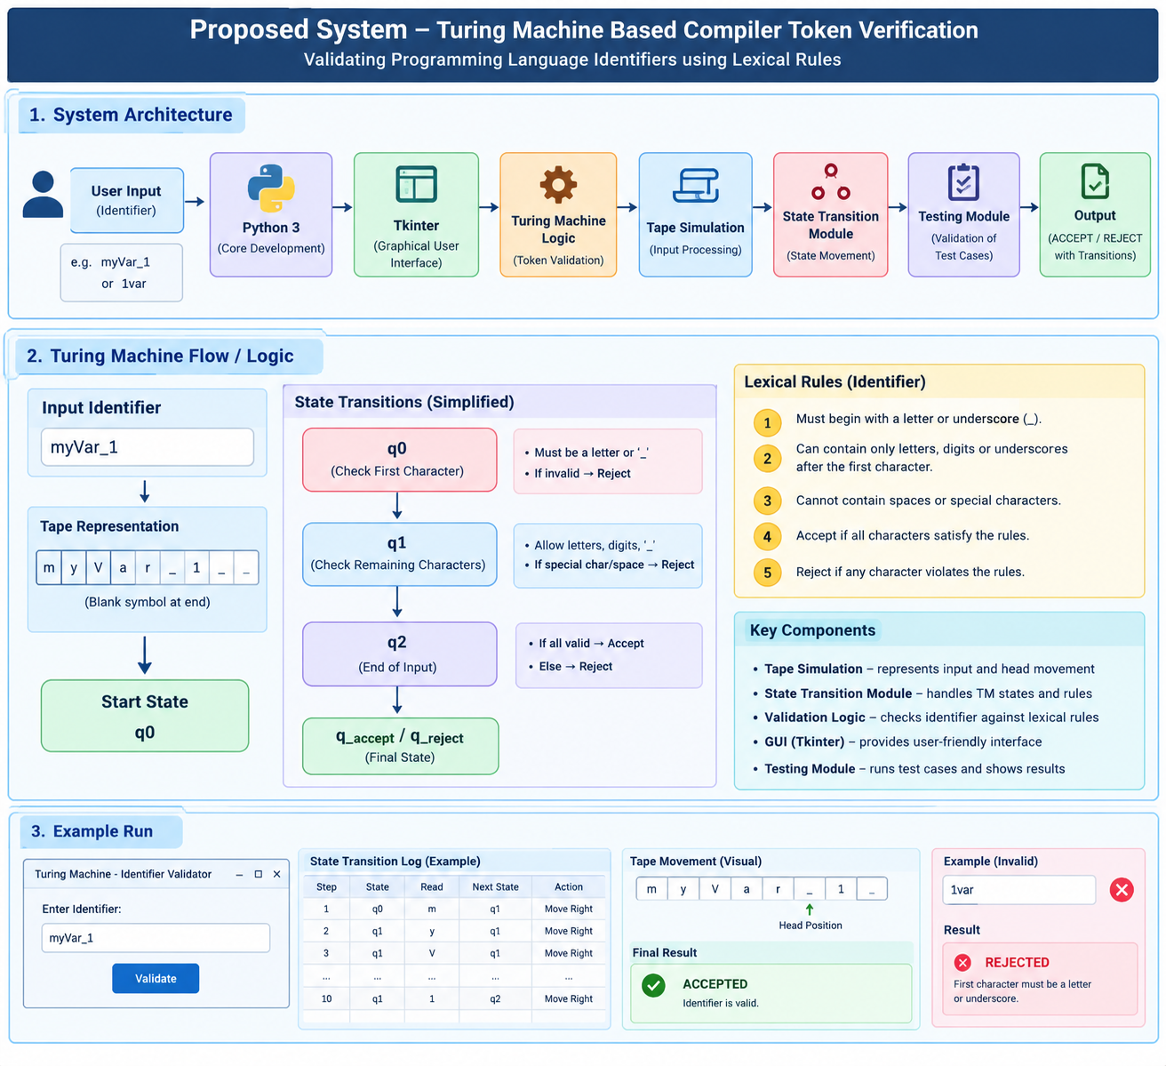
Proposed System
SMART Objectives
Sanjivani COE | Department of Computer Engineering | T.Y. B.Tech Computer Engineering
3

Slide 6
Technology Stack
Problem Definition
Technology Stack –
Python 3 – Core development
Tkinter – Graphical User Interface
Turing Machine Logic – Token validation
Tape Simulation – Input symbol processing
State Transition Module – State movement and transitions
Testing Module – Validation of test cases
3
Sanjivani COE | Department of Computer Engineering | T.Y. B.Tech Computer Engineering

Slide 7
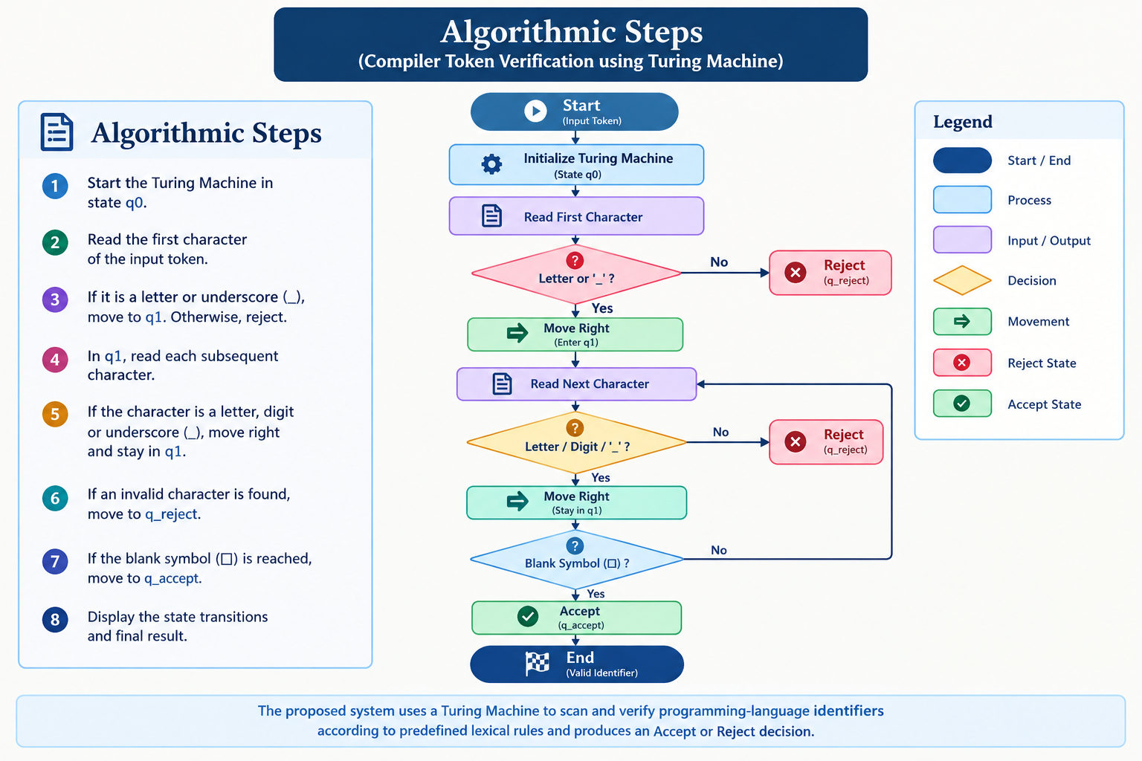
Algorithm
Problem Definition
Algorithm –
3
Sanjivani COE | Department of Computer Engineering | T.Y. B.Tech Computer Engineering

Slide 8
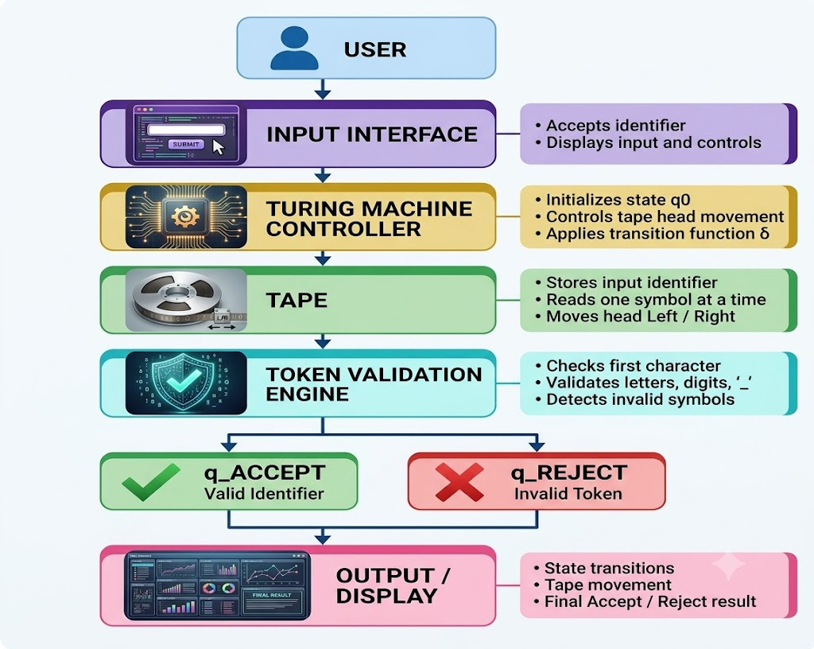
System Architecture
SMART Objectives
Sanjivani COE | Department of Computer Engineering | T.Y. B.Tech Computer Engineering
3

Slide 9
Output
Output -
Input: Displays the programming identifier entered by the user.
• State Transition: Displays the Turing Machine's current state and transition for each character.
• Tape Movement: Shows the tape head moving right while scanning the identifier.
• Validation Result: Determines whether each character follows the specified lexical rules.
• Final Result: Displays ACCEPTED for a valid identifier or REJECTED for an inval
Sanjivani COE | Department of Computer Engineering | T.Y. B.Tech Computer Engineering
3

Slide 10
Key Features
Key Features -
Turing Machine-based validation
Character-by-character scanning
First-character validation
Remaining-character validation
Accept/Reject states
State transition visualization
Tape head movement display
Invalid-character detection
Easy-to-understand simulator
Demonstrates application of TOC concepts in compiler design
Sanjivani COE | Department of Computer Engineering | T.Y. B.Tech Computer Engineering
3

Slide 11
Conclusion
EEE Format
Conclusion –
The proposed Compiler Token Verification using Turing Machine demonstrates how Theory of Computation concepts can be applied to compiler design.
The Turing Machine scans an identifier character by character and verifies whether it follows the specified lexical rules.
The system clearly displays the state transitions and final Accept/Reject decision, making the validation process easy to understand.
This case study provides a practical understanding of Turing Machines, transition functions, tape operations, and lexical analysis.
Sanjivani COE | Department of Computer Engineering | T.Y. B.Tech Computer Engineering

Slide 12
Sanjivani College of Engineering, Kopargaon
(An Autonomous Institute, Affiliated to SPPU, Pune)
Department of Computer Engineering, NBA Tier-1 Accredited
Thank You
www.sanjivanicoe.org.in

